Slide 1
CHAPTER - III WORKING WITH FUNCTIONS

Slide 2
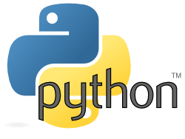
REFERENCE BOOK SUMITA ARORA

Slide 3
What is Function?

Slide 4
What is Function?
A function is a group of statements that is executed when it is called from some point of the program.
It’s a divide and conquer approach

Slide 5
TYPES OF FUNCTIONS

Slide 6
TYPES OF FUNCTIONS
Functions can be categorized into three types:-
1) Built in Functions.
2) Modules.
3) User - defined functions.

Slide 7
TYPES OF FUNCTIONS
1) BUILT IN FUNCTIONS
These are predefined function in python and are used as and when there is need by simply calling them. For example:
int() float() str() min() max() ...etc

Slide 8
TYPES OF FUNCTIONS
2) MODULES
Module is a container of functions, variables, constants, class in a separate file which can be reused.

Slide 9
IMPORTING MODULES
i) Import statement ii) from statement

Slide 10
IMPORTING MODULES – import STATEMENT
i) import statement : used to import entire module. Syntax: import modulename example: import math

Slide 11
IMPORTING MODULES – import STATEMENT
ii) from: import all functions or selected one. Syntax: from module name import function name for example: from random import randint

Slide 12
3) USER DEFINED FUNCIONS
Function is a set of statements that performs specific task.
Syntax of user defined function
def function_name(list of parameters) ................ ................ Statements
def is keyword

Slide 13
3) USER DEFINED FUNCIONS
def sum_diff(x,y): add=x+y diff=x-y return add,diff
def main(): x=9 y=3 a,b=sum_diff(x,y) print("Sum = ",a) print("diff = ",b) main()

Slide 14
PARAMETERS AND ARGUMENTS IN FUNCTION
Parameters are the values which are provided at the time of function definition.
def sum_diff(p,q): add=p+q diff=p-q return add,diff
Parameters
Parameter is also called as formal parameter or formal argument

Slide 15
PARAMETERS AND ARGUMENTS IN FUNCTION
Arguments are the values which are passed while calling a function
def main(): x=9 y=3 a,b=sum_diff(x,y) print("Sum = ",a) print("diff = ",b) main()
Arguments
Parameter is also called as formal parameter or formal argument

Slide 16
Python supports following type of arguments:
TYPES OF ARGUMENTS
Positional arguments
Default Arguments
Keyword Arguments
Variable Length Arguments

Slide 17
These are the arguments passed to a function in correct positional order
1. POSITIONAL ARGUMENTS
For example:
def substract(a,b):
print(a-b)
substract()
>>substract(100,200)
-100
>>substract(150,100)
50

Slide 18
When a function call is made without arguments, the function has defalut values for it for example:
2. DEFAULT ARGUMENTS
For example:
def greet_msg(name=“Mohan”):
print(“Hello “, name)
greet_msg()
greet_msg(“Vinay”) # valid
greet_msg() #valid

Slide 19
When a function call is made without arguments, the function has default values for it for example:
2. DEFAULT ARGUMENTS
For example:
def greet_msg(name=“Mohan”,msg=“GoodMorning”):
print(name,msg)
greet_msg()
def greet_msg(name=“Mohan”,msg): # invalid
print(name,msg)
greet_msg()

Slide 20
if function containing many arguments, and we wish to specify some among them, then value for such parameter can be provided by using the name
3. KEYWORD ARGUMENTS
For example:
def greet_msg(name,msg):
print(name,msg)
greet_msg()
#calling function
greet_msg(name=“Mohan”,msg=“Hi”): # valid
O/p -> Mohan Hi

Slide 21
3. KEYWORD ARGUMENTS
For example:
#calling function
greet_msg(msg=“Hi”,name=“Mohan”): # valid
O/p -> Mohan Hi

Slide 22
4. VARIABLE LENGTH ARGUMENTS
In some situation one needs to pass as many as argument to a function, python provides a way to pass number of argument to a function, such type of arguments are called variable length arguments.
Variable length arguments are defined with * symbol.
For Example: (next slide)

Slide 23
4. VARIABLE LENGTH ARGUMENTS
For Example:
def sum(*n):
total=0
for i in n:
total+=i
print(“Sum = “, total)
sum()
# Calling function
sum() o/p sum=0
sum(10) o/p sum=10
sum(10,20,30,40) o/p sum=100

Slide 24
PASSING ARRAYS/LISTS TO FUNCTIONS
Arrays in basic python are lists that contain mixed data types and can be passed as an argument to a function.
For Example: # Arithmetic mean of list
def list_avg(lst):
l=len(lst)
sum=0
for i in lst:
sum+=i
return sum/l
def main():
print(“Input integers”)
a=input()
a=a.split()
for i in range(len(a) ):
a[i]=int(a[i])
avg=list_ave(a)
print (“Average is = “, avg)

Slide 25
SCOPE OF VARIABLES
Scope mean measure of access of variable or constants in a program. Generally there are two types of scope of variables:
i) Global (Module)
ii) Local (Function)
Global variables are accessed throughout the program their scope is global
Local variables are accessed within the program and their scope is local only.

Slide 26
GLOBAL VARIABLES & LOCAL VARIABLES
For Example:
def main():
x=9
y=3
a,b=add_diff(x,y)
print("Sum = ",a)
print("diff = ",b)
print("m in main function = ",m)
main()
GLOBAL VARIABLE
LOCAL VARIABLES
m=100
def add_diff(x,y):
add=x+y
diff=x-y
global m
m= m +10
print("m in add_diff function=",m)
return add,diff

Slide 27
RECURSION
A recursive function is a function that calls itself until a “base condition” is true, and execution stops. While false
Recursion in computer science is a method of solving a problem where the solution depends on solutions to smaller instances of the same problem (as opposed to iteration). ...
Most computer programming languages support recursion by allowing a function to call itself from within its own code.

Slide 28
ADVANTAGES OF RECURSION
Recursive functions make the code look clean and elegant.
A complex task can be broken down into simpler sub-problems using recursion.
Sequence generation is easier with recursion than using some nested iteration.

Slide 29
DISADVANTAGES OF RECURSION
Sometimes the logic behind recursion is hard to follow through.
Recursive calls are expensive (inefficient) as they take up a lot of memory and time.
Recursive functions are hard to debug.

Slide 30
RECURSION - PROGRAM
Factorial of given number using recursion:
def factorial(n):
if n == 1:
return 1
else:
return n * factorial(n-1)

Slide 31
RECURSION - PROGRAM
We can track the recursive function:
def factorial(n):
print("factorial has been called with n = " + str(n))
if n == 1:
return 1
else:
res = n * factorial(n-1)
print("intermediate result for ", n, " * factorial(" ,n-1, "): ",res)
return res
print(factorial(5))

Slide 32
RECURSION - PROGRAM
factorial has been called with n = 5
factorial has been called with n = 4
factorial has been called with n = 3
factorial has been called with n = 2
factorial has been called with n = 1
intermediate result for 2 * factorial( 1 ): 2
intermediate result for 3 * factorial( 2 ): 6
intermediate result for 4 * factorial( 3 ): 24
intermediate result for 5 * factorial( 4 ): 120
120

Slide 33
RECURSION - PROGRAM
Fibonacci series using recursive function:
def fib(n):
if n == 0:
return 0
elif n == 1:
return 1
else:
return fib(n-1) + fib(n-2)

Slide 34
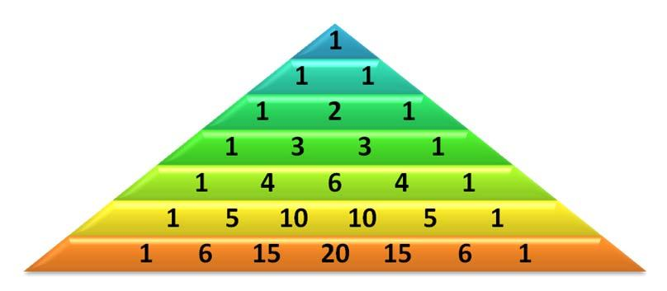
RECURSION - PROGRAM
creating the Pascal triangle using recursion:

Slide 35
RECURSION - PROGRAM
creating the Pascal triangle using recursion:
#to print a pascal triangle of 'n' rows
def factorial(val):
if val==1:
return val
else:
return val*factorial(val-1)

Slide 36
RECURSION - PROGRAM
creating the Pascal triangle using recursion:
def combination(n,r):
if n<r or r==0 or r==n:
t=1
return int(t)
else:
t=factorial(n)/(factorial(r)*factorial(n-r))
return int(t)

Slide 37
RECURSION - PROGRAM
creating the Pascal triangle using recursion:
def pascal(x):
print('\t'*x,end='1\n')
for row in range(1,x):
gaps=x-row
for j in range(gaps,0,-1):
print('\t',end='')
Contd…

Slide 38
RECURSION - PROGRAM
creating the Pascal triangle using recursion:
for b in range(row):
val=combination(row,b)
print(val,end='\t\t')
print('1')
x=int(input('Enter the no. of rows :'))
pascal(x)

Slide 39
RECURSION - PROGRAM
Tower of Hanoi Python Program
Tower of Hanoi is a mathematical puzzle where we have three rods and n disks. The objective of the puzzle is to move the entire stack to another rod, obeying the following simple rules:
1) Only one disk can be moved at a time.
2) Each move consists of taking the upper disk from one of the stacks and placing it on top of

Slide 40
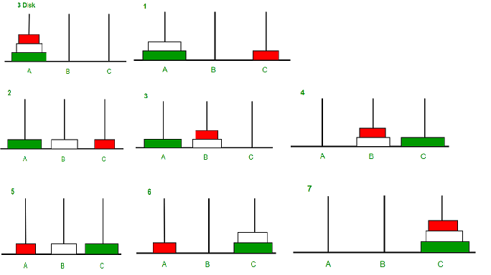
RECURSION - PROGRAM
Tower of Hanoi Python Program
another stack i.e. a disk can only be moved if it is the uppermost disk on a stack.
3) No disk may be placed on top of a smaller disk.

Slide 41
RECURSION - PROGRAM
Tower of Hanoi Python Program
def TowerOfHanoi(n , from_rod, to_rod, aux_rod):
if n == 1:
print ("Move disk 1 from rod",from_rod,"to rod",to_rod )
return
TowerOfHanoi(n-1, from_rod, aux_rod, to_rod)
print( "Move disk",n,"from rod",from_rod,"to rod",to_rod )
TowerOfHanoi(n-1, aux_rod, to_rod, from_rod)

Slide 42
RECURSION - PROGRAM
Tower of Hanoi Python Program
# Driver code
n = 4
TowerOfHanoi(n, \'A\', \'C\', \'B\')
# A, C, B are the name of rods

Slide 43
RECURSION - PROGRAM
# Python program to find the H.C.F of two input number
# define a function
def computeHCF(x, y):
# choose the smaller number
if x > y:
smaller = y
else:
smaller = x
for i in range(1, smaller+1):
if((x % i == 0) and (y % i == 0)):
hcf = i
return hcf
def gcd(a,b):
if(b==0):
return a
else:
return gcd(b,a%b) a=int(input("Enter first number:")) b=int(input("Enter second number:"))
GCD=gcd(a,b)
print("GCD is: ") print(GCD)

Slide 44
RECURSION - PROGRAM
# take input from the user
# num1 = int(input("Enter first number: "))
# num2 = int(input("Enter second number: "))
print("The H.C.F. of", num1,"and", num2,"is", computeHCF(num1, num2))

Slide 45
RECURSION - PROGRAM
def sum_recursive(current_number, accumulated_sum):
# Base case
# Return the final state
if current_number == 11:
return accumulated_sum
# Recursive case
# Thread the state through the recursive call
else:
return sum_recursive(current_number + 1, accumulated_sum + current_number)

Slide 46
RECURSION - PROGRAM
1 Recursive Python function to find sum of natural numbers.
2. Recursive Python function to find sum of even numbers.
3. Recursive Python function to find sum of odd numbers.
4. Recursive Python function to find sum of fib series.
5. Recursive Python function to find given number is prime or not.

Slide 47
Class Test
Which of the following is the use of function in python?
a) Functions are reusable pieces of programs b) Functions don’t provide better modularity for your application c) you can’t also create your own functions d) All of the mentioned
2. Which keyword is use for function? a) Fun b) Define c) def d) Function

Slide 48
Class Test
3. What is the output of the below program?
def sayHello():
print('Hello World!')
sayHello()
sayHello()
a) Hello World! Hello World! b) ‘Hello World!’ ‘Hello World!’ c) Hello Hello

Slide 49
Class Test
4. What is the output of the below program?
def printMax(a, b):
if a > b:
print(a, 'is maximum')
elif a == b:
print(a, 'is equal to', b)
else:
print(b, 'is maximum')
printMax(3, 4)
a) 3 b) 4 c) 4 is maximum d) None of the mentioned

Slide 50
Class Test
5. What is the output of the below program ?
x = 50
def func(x):
print('x is', x)
x = 2
print('Changed local x to', x)
func(x)
print('x is now', x)
a) x is now 50 b) x is now 2 c) x is now 100 d) None of the mentioned

Slide 51
Class Test
6. What is the output of the below program?
x = 50
def func():
global x
print('x is', x)
x = 2
print('Changed global x to', x)
func()
print('Value of x is', x)
a) x is 50 Changed global x to 2 Value of x is 50 b) x is 50 Changed global x to 2 Value of x is 2 c) x is 50 Changed global x to 50 Value of x is 50 d) None of the mentioned

Slide 52
Class Test
7. What is the output of below program?
def say(message, times = 1):
print(message * times)
say('Hello')
say('World', 5)
a) Hello WorldWorldWorldWorldWorld b) Hello World 5
c) Hello World,World,World,World,World d) Hello HelloHelloHelloHelloHello

Slide 53
Class Test
8. What is the output of the below program?
def func(a, b=5, c=10):
print('a is', a, 'and b is', b, 'and c is', c)
func(3, 7)
func(25, c = 24)
func(c = 50, a = 100)
a) a is 7 and b is 3 and c is 10 a is 25 and b is 5 and c is 24 a is 5 and b is 100 and c is 50
b) a is 3 and b is 7 and c is 10 a is 5 and b is 25 and c is 24 a is 50 and b is 100 and c is 5 c) a is 3 and b is 7 and c is 10 a is 25 and b is 5 and c is 24 a is 100 and b is 5 and c is 50 d) None of the mentioned

Slide 54
Class Test
9. What is the output of below program?
def maximum(x, y):
if x > y:
return x
elif x == y:
return 'The numbers are equal'
else:
return y
print(maximum(2, 3))
2 b) 3 c) The numbers are equal
d) None of the mentioned

Slide 55
Class Test
10. Which of the following is a features of DocString?
a) Provide a convenient way of associating documentation with Python modules, functions, classes, and methods b) All functions should have a docstring c) Docstrings can be accessed by the __doc__ attribute on objects d) All of the mentioned

Slide 56
Class Test
1 A
2 C
3 A
4 C
5 A
6 B
7 A
8 C
9 B
10 D

Slide 57
Thank You

